Slide 1

CDNA Delegates Meeting
Tuesday 9th February, 2021

Slide 2
WELCOME

Slide 3
NEW COMMITTEE MEMBERS
CDNA
Clubs and Teams

Slide 4
NEW TEAMS / CLUBS
Nobel Ninjas

Slide 5
CDNA STAFF
Penny Forrest – Netball Operations Manager
Cheryl Carter – Book keeper
Jen McIntyre – Head Representative Coach
Lucy Barker – Umpire Coordinator
Molly Rosenberger – Net Set Go Coordinator
Simone Belli – Canteen Manager
CONTROL BOX STAFF - Sat (Janine Venturoni and Bea Catella)
- Fri (Hannah Rosenberg, Sidney Peel-Hope, Emily Venturoni)
CDNA Committee, Canteen Staff, Umpire Supervisors, Umpire Mentors, Umpires, Cleaner (David)

Slide 6
NEW POLICIES
Codes of Behaviour (players, officials, spectators)
Grading Policy
Communications Policy
Social Media Policy
Cyberbullying Policy
Life Membership Policy
Sunsmart Policy
First Aid Policy
Member Protection, Child Safety, Concussion, Pregnancy

Slide 7
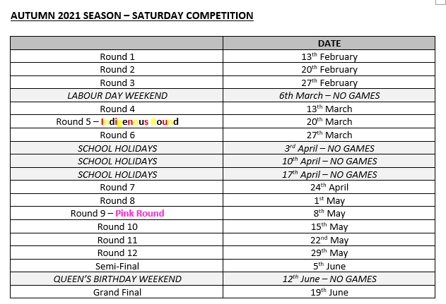
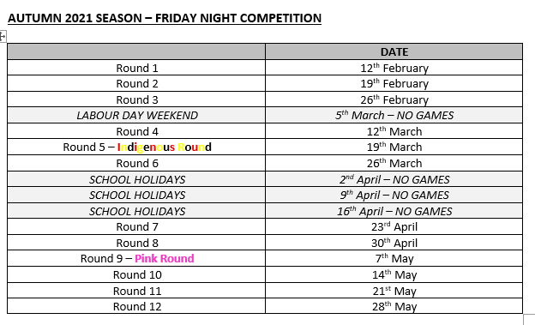
SEASON DATES
Notes:
Note the special rounds

Slide 8


SEASON DATES

Slide 9
TRAINING COURTS

Slide 10
SEASON INVOICES
Notes:
Sent today – please pay by Friday

Slide 11
NETBALL VICTORIA MEMBERSHIP
All players, umpires and coaches MUST have a full membership every year
Single Game Vouchers – online only (https://netball.resultsvault.com/common/pages/reg/welcome.aspx?type=1&id=93368&entityid=39427)

Slide 12
NET SET GO
An important program for young netballers
CDNA run their own Net Set Go program in Terms 2 and 3 every year
It is run on a Friday night from 4pm-4:45pm
Our NSG coordinator is Molly Rosenberger
Any enquiries to netsetgo@cdna.net.au

Slide 13
SCORE SHEETS

Slide 15
11/U DIVISION
Uniform
Spectators / coaches
Rotations
Car Parking

Slide 16
MIXED DIVISIONS
Our vision is to offer separate 15/U and 17/U mixed divisions and eventually Open aged
Lots of discussions and planning to be done
We need club support and help getting it out and raising interest
Spring 2021

Slide 17
EXEMPTIONS
Uniforms
Players – filling in / finals qualifications
2021 is going to be a unique year for us all and CDNA are more than willing to look at any requests for uniform and player exemptions on a case-by-case basis. All we ask is to keep the communication channels open so we can work together.

Slide 18

www.inspirenetballgroup.com
THURSDAYS

Slide 19
COVID-19
https://www.dhhs.vic.gov.au/novelcoronavirus

Slide 20
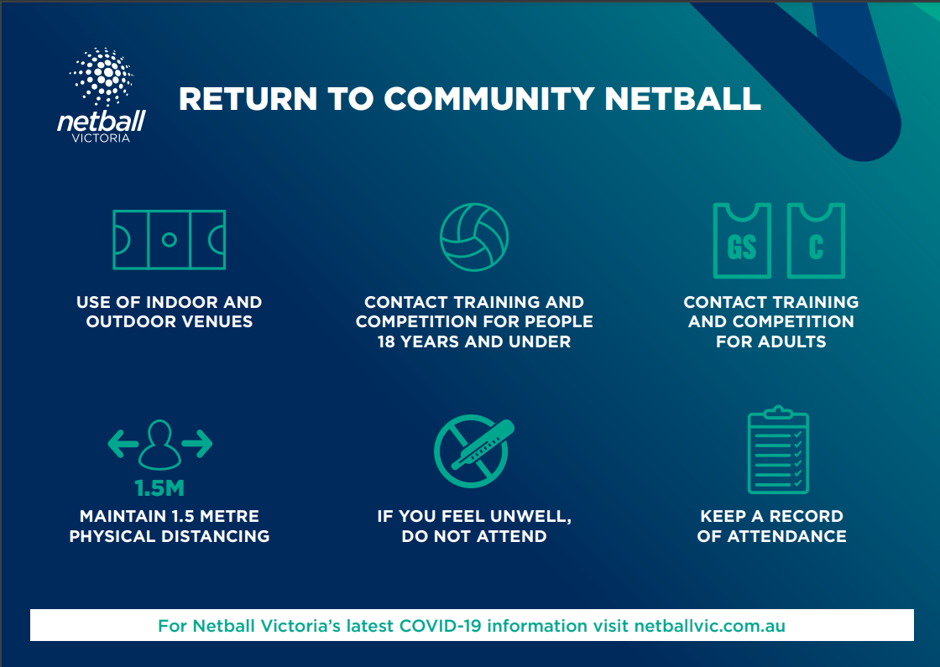

Slide 21
COVID-19
COVID Safety Plan – available on website as per government guidelines
Capacity limits – 1 spectator per person
Social distancing – 1.5 metres
Face Masks – everyone should carry a face mask
- scorers must wear face masks
Equipment – balls & score sheets (umpires bring), goal posts (umpires clean), bibs (we can no longer lend), first aid kits
Timings – game times shortened by 1 minute per quarter and groups leaving immediately/not congregating
Procedures – increased cleaning / cash handling (EFTPOS!)
Entry / Exit points (next slide) – please use the nearest one
Contact Tracing – QR code for everyone important
COVID Safety Officers

Slide 22
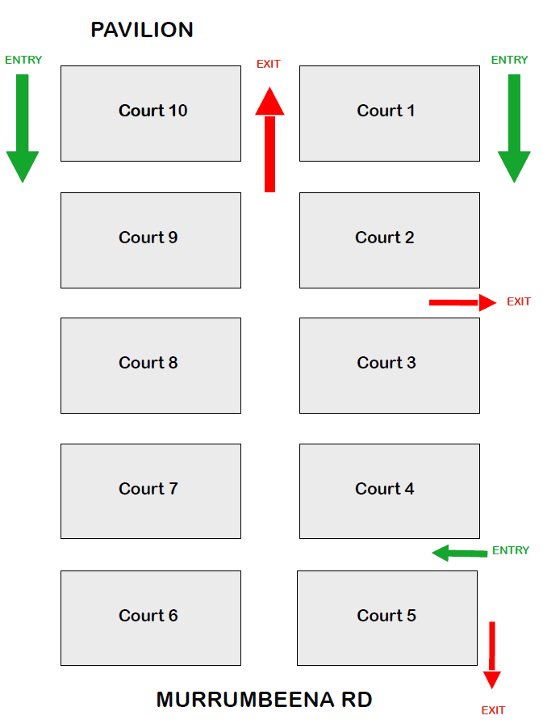

Slide 23
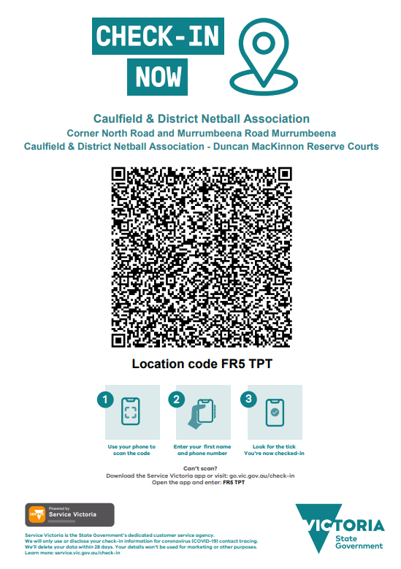

Slide 24
FIXTURES
Grading process
Released tonight
Where to find them – www.cdna.net.au -> ‘Competition’ -> ‘Domestic Fixtures’
Results and ladders will not be published for grading
After grading, all points and scores will start from 0 again.
Finals times – different and already on fixture. PLEASE TAKE NOTE!
NOTE – All grades are …./Under not Under …..

Slide 25
UMPIRE COORDINATOR

Slide 26
C Badge & B Skills
New Umpire Trainee Program
Inspire Workshops
U/11 Solo Umpiring
New Umpire Trail Day – Death to the waiting list!

Slide 27
CDNA Member Feedback Survey
Mid week competition was popular
Alternative programs such as All Abilities, Mixed and fast 5 gained a lot of support
Communication: 63% indicated their ideal communication method was direct email from the association rather than communications forwarded from their club or communications via social media

Slide 28
QUESTIONS?

Slide 29
ATHLETICS MEET NOTIFICATION!!!

Slide 30
COMMUNICATIONS 0409 022 093

Slide 31


Slide 32
THANK YOU & GOOD LUCK! ☺

